Slide 1
ZanHotel-Ajira Portal
A Web-Based Recruitment System
Student Name: Gidion Mkasanga Gidion
Registration Number: BITAM/9/21/002/T
Supervisor: Mr Akram Omar

Slide 2
Introduction
Manual hotel recruitment is inefficient
No centralized job platform
System connects hotels and job seekers
Built using React and Django

Slide 3
Feasibility Study
Economic: Low cost (open-source tools),
System is implementable with available tools.
Operational: Easy to use system
Technologies: React, Django, PostgreSQL

Slide 4
Methodology
Agile / Iterative Development
Requirement Analysis
System Design (SRS & SDD)
Implementation
Testing and Deployment

Slide 5
Functional Requirements
Job Seeker: Register, login, view jobs, apply
, Upload CV, certificates, photo
Hotel: Register, login, post jobs
, View applications and manage postings

Slide 6
Non-Functional Requirements
Security: Authentication & authorization
Performance: Fast response time
Scalability: Supports many users and integration.
Usability: User-friendly interface
Reliability: High availability

Slide 7
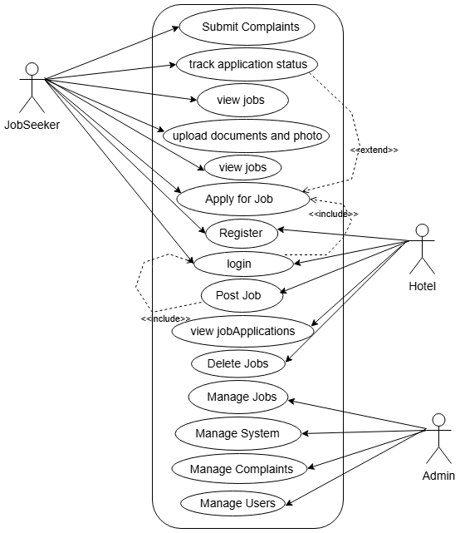
Use Case Diagram

Slide 8
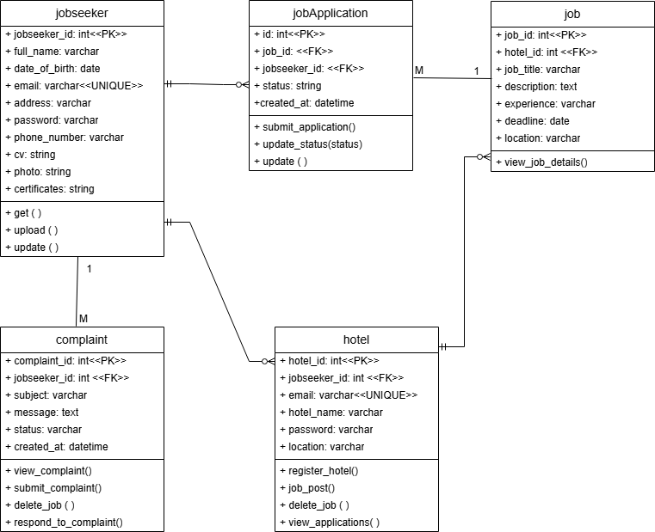
Class Diagram

Slide 9
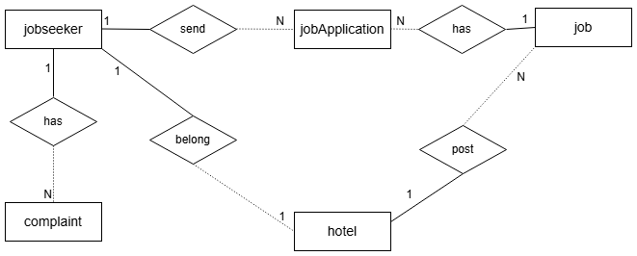
ER Diagram

Slide 10
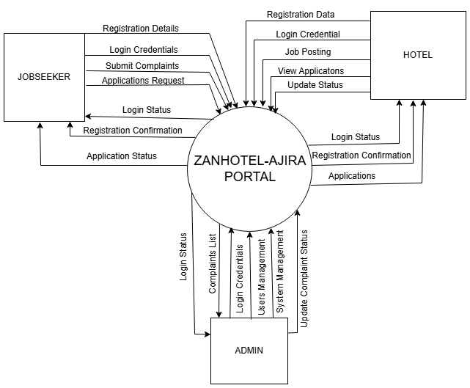
Data Flow Diagram: Level 0

Slide 11
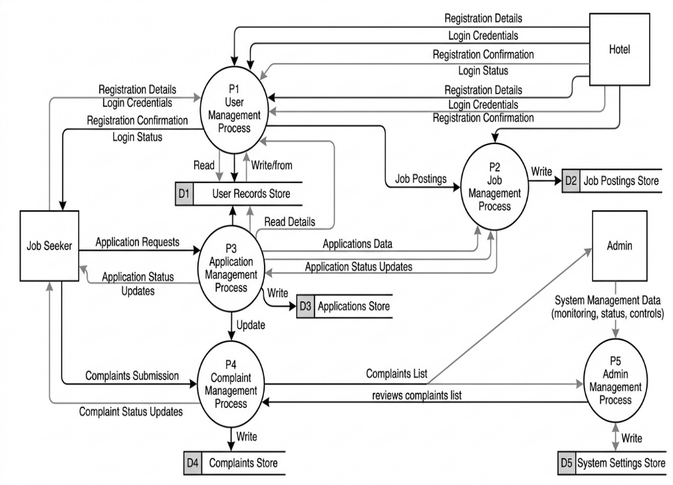
Data Flow Diagram: Level 1

Slide 12
System Architecture
Client-Server Architecture
Frontend: React
Backend: Django REST API
Database: PostgreSQL

Slide 13
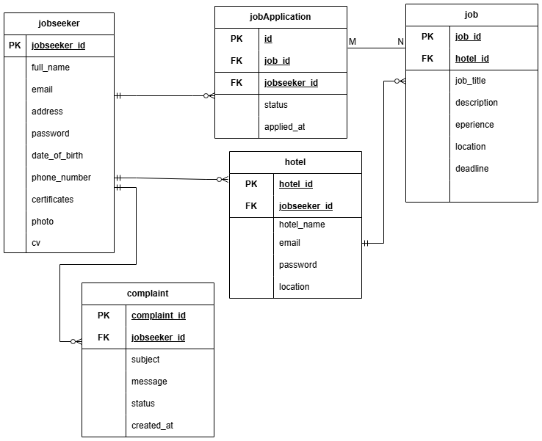
Database Relational Model

Slide 14
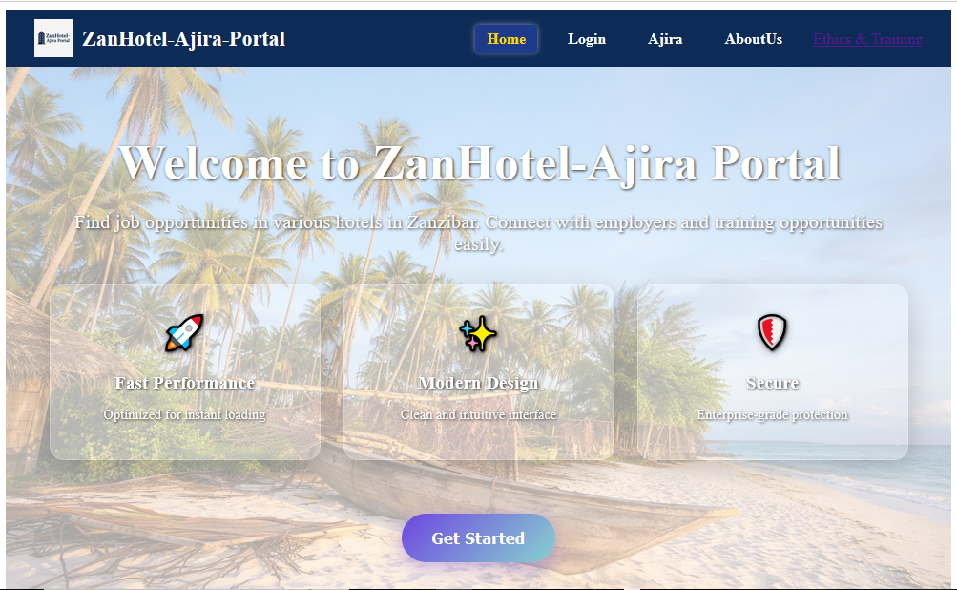
Design Demonstration

Slide 15
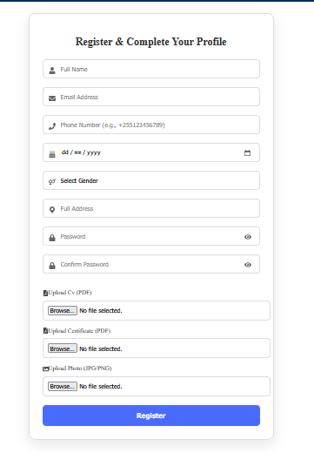
Design Demonstration

Slide 16
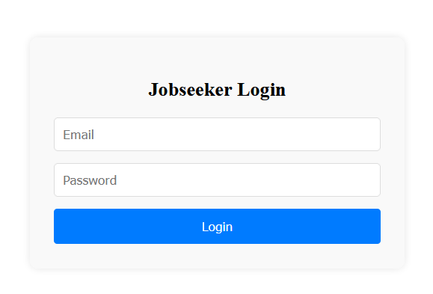
Design Demonstration

Slide 17
Conclusion
Developed a functional job portal
Improved recruitment efficiency

Slide 18
Thank You

